Slide 1

Automatic recognition of violence-related content on social media .
Realized by :
Supervised by :
BOUFOUS BOUCHRA
EL-OUARDI YASSINE CHARAF OUALID
Pr H. Mousannif
Aider votre entreprise à atteindre de plus grandes hauteurs

Slide 2
Plan
01
Introduction
05
Feature Extraction
02
Data Collection
06
Model training
03
Dataset Construction
07
Model Evaluation
04
Data Preprocessing
08
Model deployment

Slide 3
01
INTRODUCTION
The project "Automatic Recognition of Violence-Related Content on Social Media (Text Mining)" focuses on using text mining techniques to detect and classify violent content in messages posted on social media. The main objective of this project is to develop a predictive model that can identify potentially violent messages, enabling quick and effective intervention to prevent harmful online behaviors.
The project aims to apply natural language processing (NLP) techniques to analyze and understand messages posted on social media. Specifically, it focuses on detecting violence-related content, such as hate speech, threats, bullying, and offensive messages. The goal is to develop an automatic classification model that can accurately identify toxic and non-toxic messages.

Slide 4
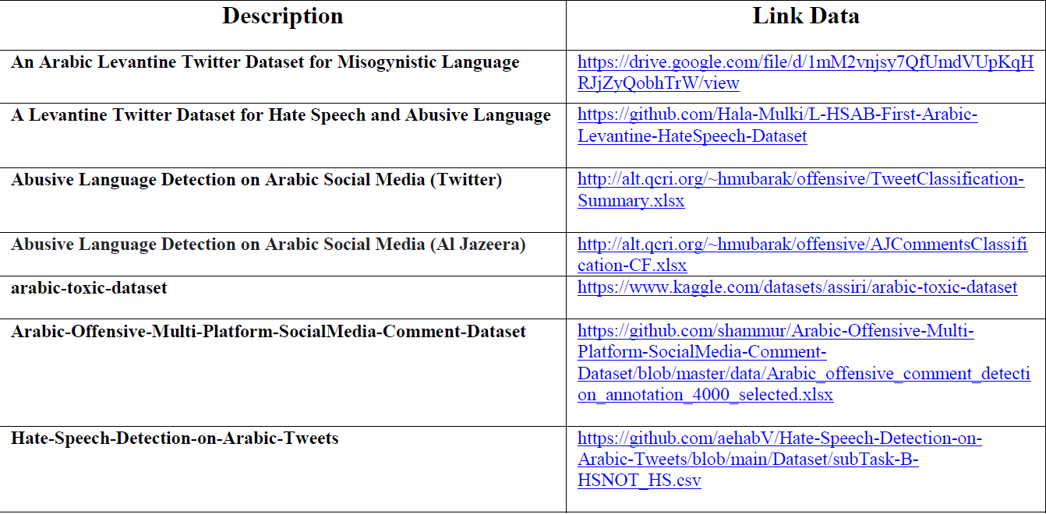
02
Data Collection
In this step, relevant data is collected from various sources, such as social media platforms, online forums, or public databases. The data include textual messages, associated metadata, and toxicity or no toxicity annotations
Datasets Links

Slide 5
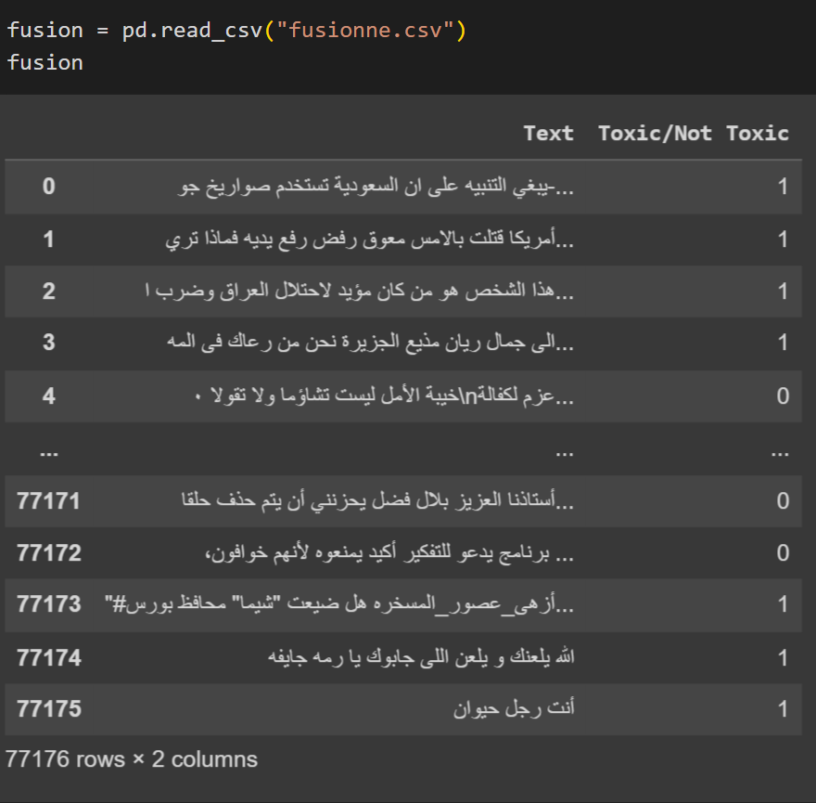
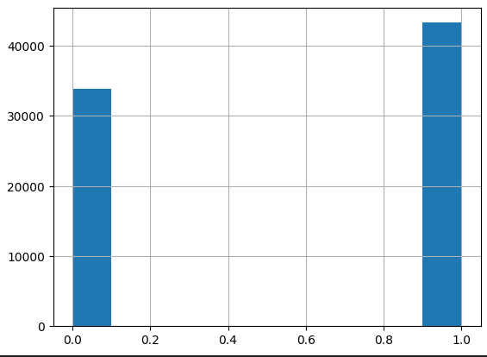
03
Dataset Construction
After collecting the data, we merged it into a single file and the preprocessed data is divided into two main columns: the "Text" column containing the messages posted on social media, and the "Toxic/Not Toxic" column indicating whether the message is toxic(1) or non-toxic(0). The dataset consists of 77,176 instances.

Slide 6
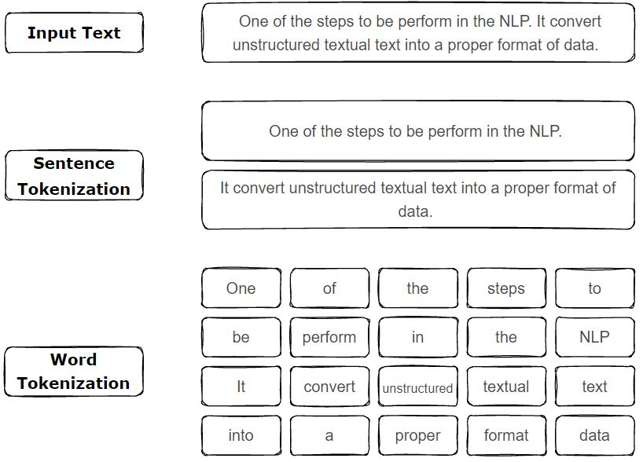
04
Data Preprocessing
Tokenization
Tokenization is the process of breaking down a text into smaller units, such as words or subwords.
It is an essential step in natural language processing as it helps to extract meaningful information from the text.

Slide 7
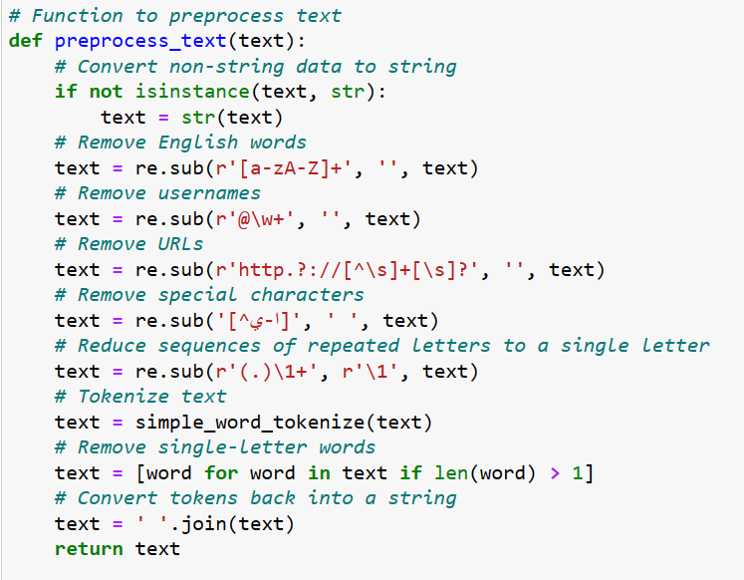
04
Data Preprocessing
Data Cleaning

Slide 8
Features Extraction
01
Word Embeddings
02
TF-IDF
03
Transformers

Slide 9
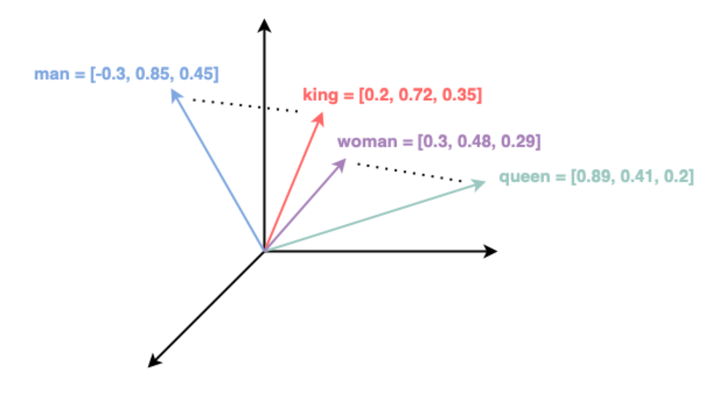
5- Features Extraction
01
Word Embeddings
Word2vec
Word embedding is a technique used in natural language processing (NLP) to represent words as dense numerical vectors. These vectors capture the semantic and syntactic information of words, allowing for the measurement of similarities and relationships between words.
Word embedding is often performed using algorithms such as Word2Vec, which learn from large text corpora to predict neighboring words given a specific word. By adjusting the model's parameters, word vectors are optimized so that words with similar contexts have similar vectors.
When words are represented as vectors, words with similar syntactic or semantic relationships are represented by vectors that are close to each other in the vector space.

Slide 10
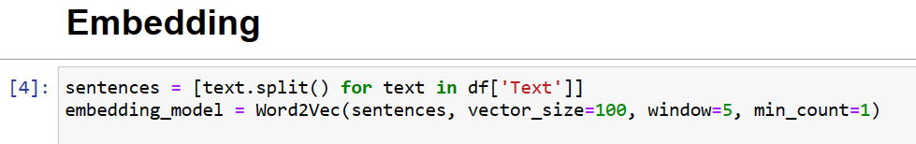
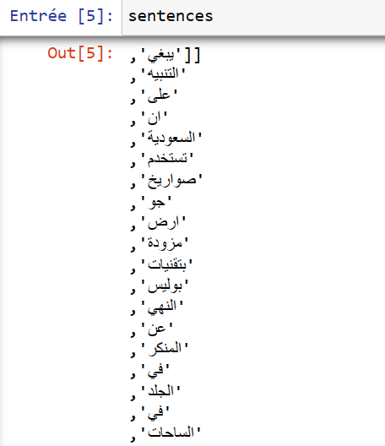
5- Features Extraction
01
Word Embeddings
Word2Vec model creation
The Word2Vec class from the gensim library is used to create the word embedding model.
The parameters for Word2Vec include:
sentences: The prepared sentences from the previous step.
vector_size: The dimensionality of the word vectors you want to obtain. In your case, you specified 100.
window: The size of the context window for predicting neighboring words.
min_count: The minimum number of occurrences a word must have to be considered in the model.

Slide 11
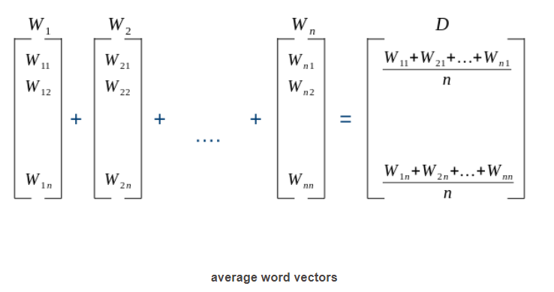
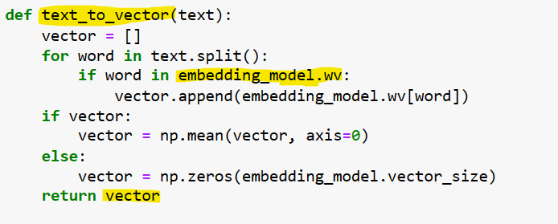
5- Features Extraction
01
Word Embeddings
Conversion of texts to word vectors
The code uses the Word2Vec model to convert texts to word vectors.
It defines a function called "text_to_vector“.
The function iterates over each word in a text.
It checks if the word exists in the embedding model.
If the word is found, the corresponding vector is added to a list.
After processing all the words, the function calculates the mean of the vectors to obtain an average vector representation of the text.
If no words are found in the embedding model, a zero vector is created.
.

Slide 12
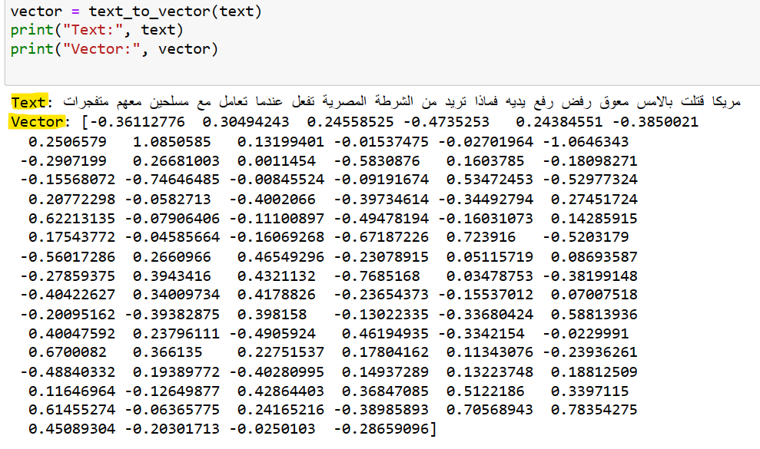
5- Features Extraction
01
Word Embeddings
Applying the “text_to_vector” function

Slide 13
5- Features Extraction
02
TF
Term Frequency, which measures how frequently a term occurs in a document. Since every document is different in length, it is possible that a term would appear much more times in long documents than shorter ones. Thus, the term frequency is often divided by the document length (aka. the total number of terms in the document) as a way of normalization:
TF(t) = (Number of times term t appears in a document) / (Total number of terms in the document)

Slide 14
5- Features Extraction
02
TF(Example)
Let’s Consider these Three sentences:
1.He is a Good Boy
2. She is a Good Girl, and,
3. Both are Good Boy, and Girl, respectively.
So, Number of times the word “Good” appears in Sentence 1 is, 1 Time,
and the Total number of times the word “Good”, appears in all three Sentences is 3 times, so the TF(Term Frequency) value of word “Good” is, TF(“Good”)=1/3=0.333.

Slide 15
5- Features Extraction
02
IDF
Inverse Document Frequency, which measures how important a term is. While computing TF, all terms are considered equally important. However it is known that certain terms, such as “is”, “of”, and “that”, may appear a lot of times but have little importance. This we need to weigh down the frequent terms while scale up the rare ones, by computing the following:
IDF(t) = log_e(Total number of documents / Number of documents with term t in it).

Slide 16
5- Features Extraction
02
IDF(Example)
lets consider the same word “Good”, in Sentence 1,Now, we know that Total Number of Sentences we have is 3(Total number of documents), also , We know the word ” Good” appears overall 3 times, considering all 3 sentences, so, Number of documents with term “Good” in it=3,
So, IDF (Inverse Document Frequency) Value of word “Good” would be “ Log(3/3)

Slide 17
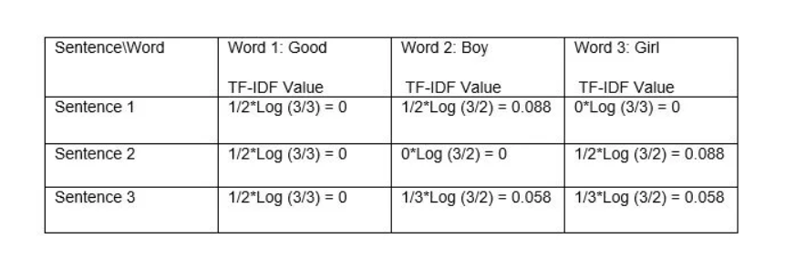
5- Features Extraction
02
TF-IDF
Now, We have Values for both, TF( Term Frequency ) as well as IDF( Inverse Document Frequency ) for each word, for each Sentence we have.
So,Finally the TF-IDF Value for each word would be=TF(Value)*IDF(Value).

Slide 18
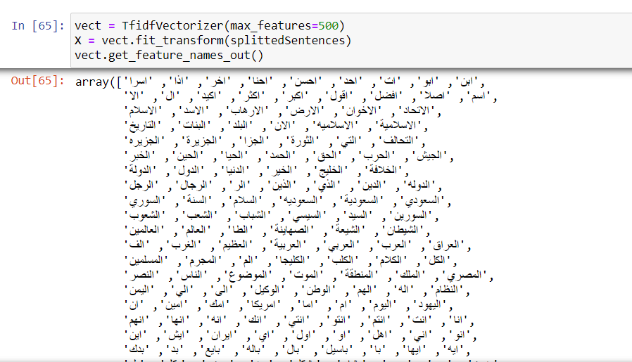
5- Features Extraction
02
TF-IDF (Conclusion)
In summary, TF-IDF assigns specific values to words, capturing their importance in a document or corpus. It overcomes the limitations of the Bag-of-Words approach, which treats all words equally. TF-IDF's weighted scores highlight important terms, improving search relevance and text analysis in NLP

Slide 19
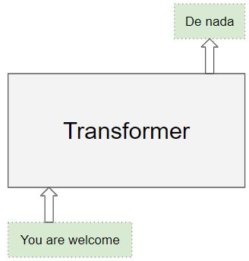
5- Features Extraction
03
Transformers
The Transformer architecture excels at handling text data which is inherently sequential. They take a text sequence as input and produce another text sequence as output. eg. to translate an input English sentence to Spanish.

Slide 20
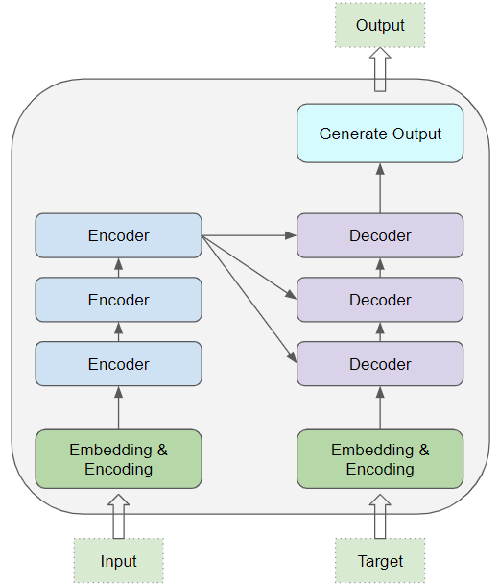
5- Features Extraction
03
Transformers
At its core, it contains a stack of Encoder layers and Decoder layers. To avoid confusion we will refer to the individual layer as an Encoder or a Decoder and will use Encoder stack or Decoder stack for a group of Encoder layers.
The Encoder stack and the Decoder stack each have their corresponding Embedding layers for their respective inputs. Finally, there is an Output layer to generate the final output.

Slide 21
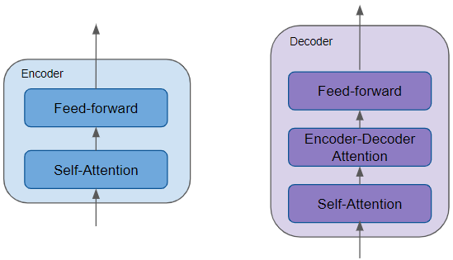
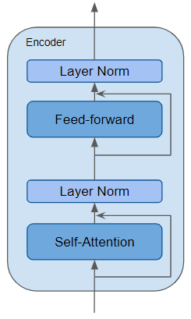
5- Features Extraction
03
Transformers
All the Encoders are identical to one another. Similarly, all the Decoders are identical.
The Encoder contains the all-important Self-attention layer that computes the relationship between different words in the sequence, as well as a Feed-forward layer.
The Decoder contains the Self-attention layer and the Feed-forward layer, as well as a second Encoder-Decoder attention layer.
Each Encoder and Decoder has its own set of weights.
The Encoder is a reusable module that is the defining component of all Transformer architectures. In addition to the above two layers, it also has Residual skip connections around both layers along with two LayerNorm layers.
There are many variations of the Transformer architecture. Some Transformer architectures have no Decoder at all and rely only on the Encoder.

Slide 22
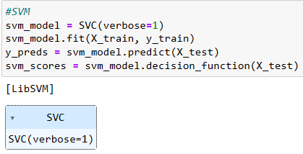
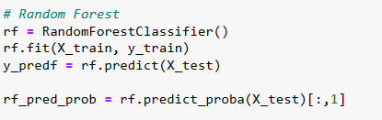
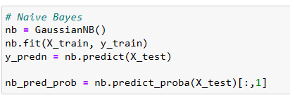
6-Model Training
01
SVM
02
Random Forests
03
Naïve Bayes

Slide 23

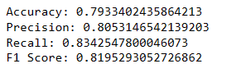
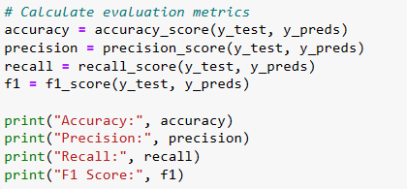

7-Model Evaluation
01
SVM
02
Random Forests
03
Naïve Bayes

Slide 24
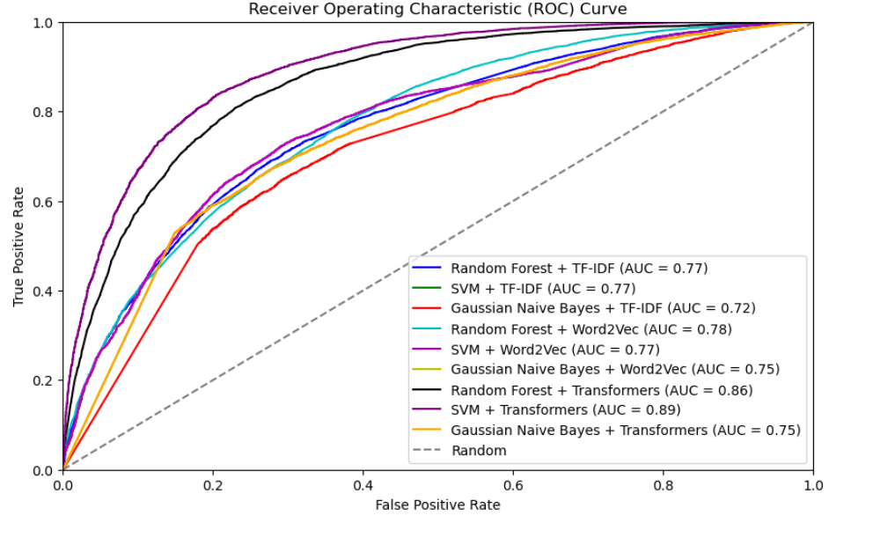
ROC (Receiver Operating Characteristic) curve
The ROC (Receiver Operating Characteristic) curve is a graphical representation of the performance of a binary classification model. It displays the relationship between the true positive rate (TPR) and the false positive rate (FPR)
True Positive Rate (TPR) focuses on correctly identifying positive instances.
False Positive Rate (FPR) focuses on incorrectly classifying negative instances as positive.

Slide 25
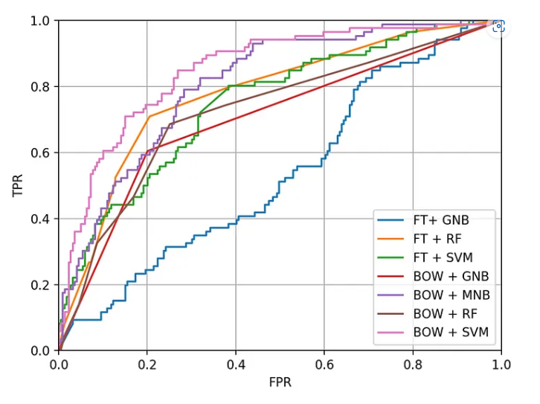
ROC (Receiver Operating Characteristic) curve
Hate Speech Detection. (Foreword by Teemu Turunen, Corporate… | by Futurice | Medium

Slide 26
8- Model
Deployment

Slide 27

Thank you

